Slide 1
Analyzing The Relationship Between Abandoned Buildings and Crime Rate
By Oliver and Anfernee

Slide 2


Why This is Important
This analysis would be particularly useful for law enforcement and government officials to test the assumption that abandoned buildings have the effect of encouraging crime (likely based on the broken windows theory).
We seek to determine whether the hypothesis of demolishing abandoned buildings has an effect on the crime rate in that area; whether it increases/decreases or there’s a change in the severity of the crimes committed.

Slide 3

Goodness
We compared our data through multiple analysis and filtered through outliers as well to make sure our data was correct.
We also confirmed our data by looking through the multiple zip codes to confirm our assumptions.
Studies done on other cities also confirm this fact.

Slide 4
Data Sources
Name: DOB-Permit-Issuance
Description: A history of all permits issued, including ones for demolishing them. Other key information such as borough and date are included.
Size of data: 1.44GB
Link to data: https://data.cityofnewyork.us/Housing-Development/DOB-Permit-Issuance/ipu4-2q9a
Name: NYPD Arrest Data
Description: A history of all arrests, boroughs, and their dates. Includes what crimes they’ve committed along with general information about the criminal.
Size of data: 31.3MB
Link to data: https://data.cityofnewyork.us/Public-Safety/NYPD-Arrest-Data-Year-to-Date-/uip8-fykc
Name: Precinct Data
Description: Scraped file of the boroughs and their respective precincts
Size of data: 44.8KB
Link to data: https://www1.nyc.gov/site/nypd/bureaus/patrol/precincts-landing.page
Name: Vacant Building Data
Description: Data of vacant buildings along with their location including boroughs
Size of data: 367MB
Link to data: https://www1.nyc.gov/assets/planning/download/zip/data-maps/open-data/nyc_pluto_21v4_csv.zip

Slide 5
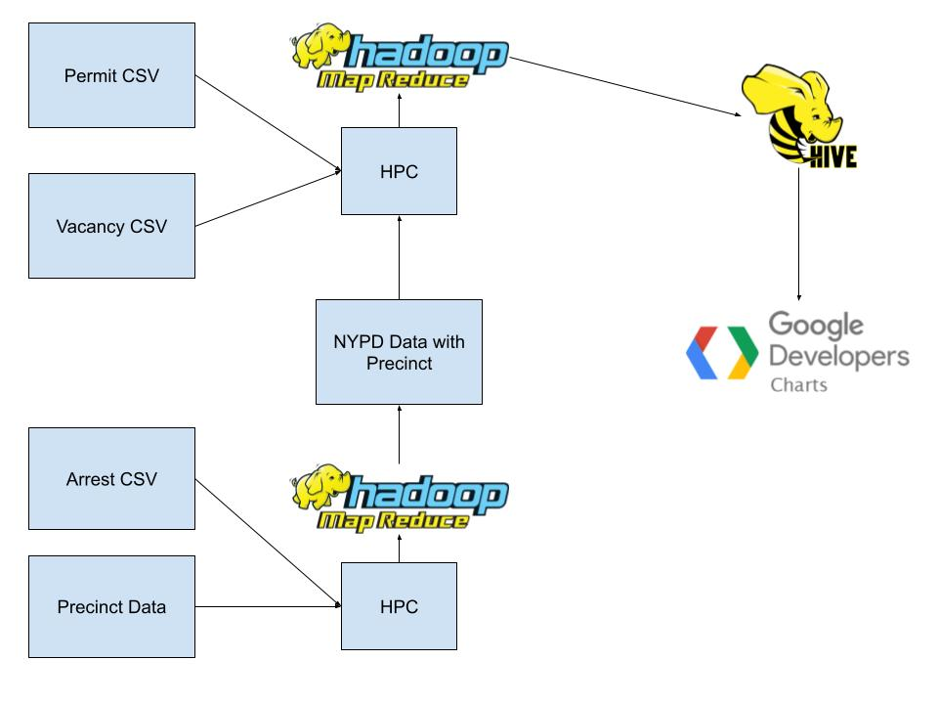
Design Diagram

Slide 6
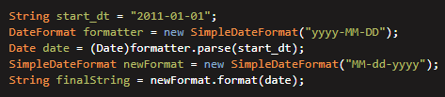
Code Challenge
Cleaning Data with Date object conversions
Manual Version

Slide 7
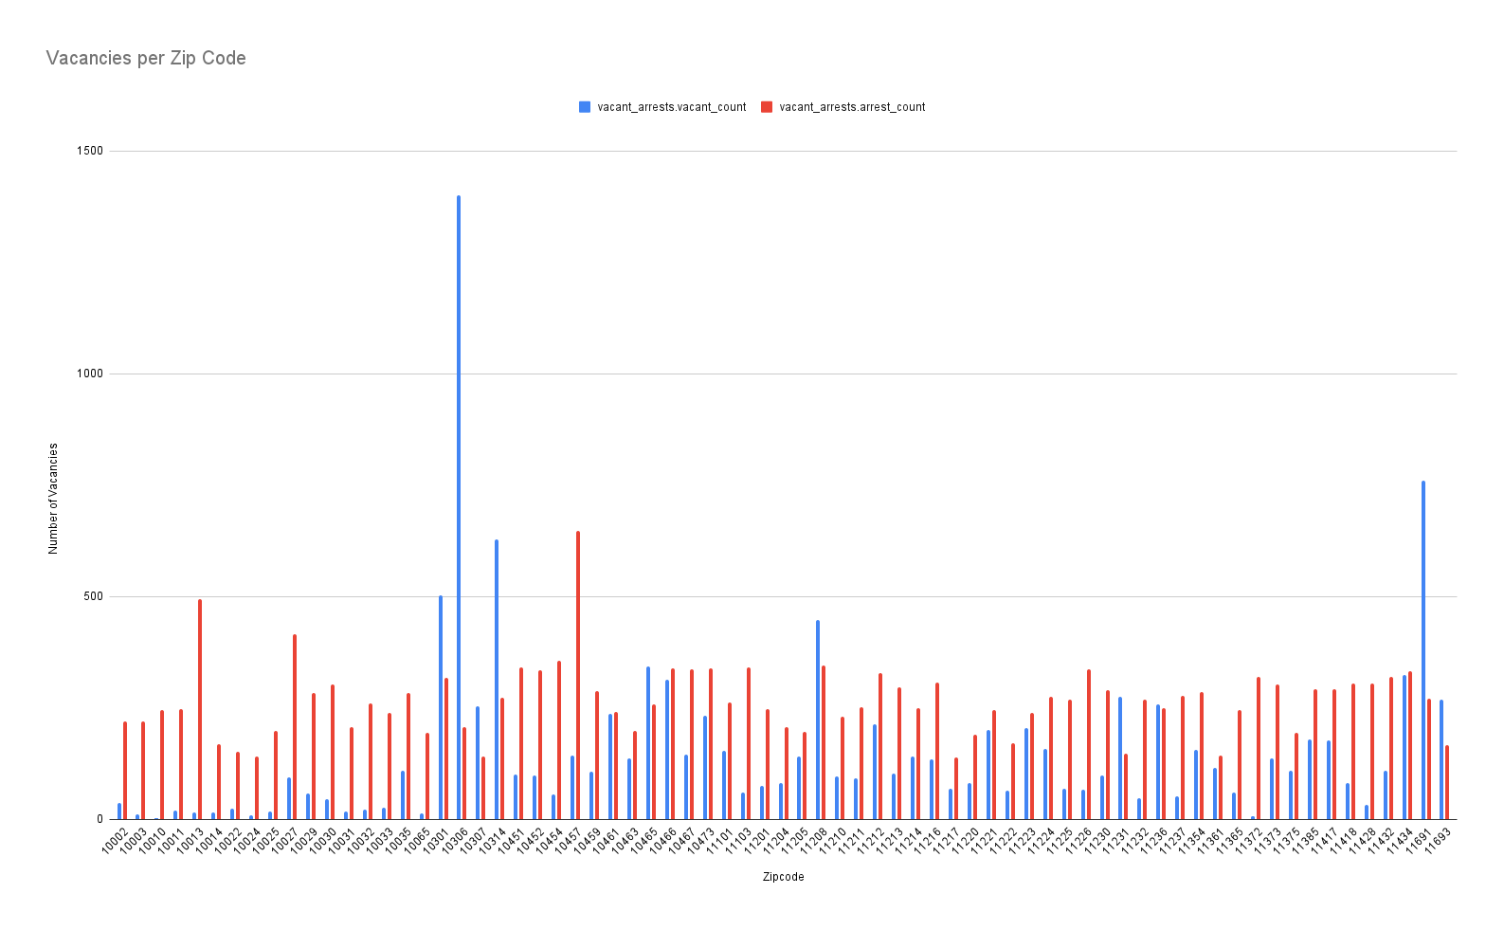
Insights
Vacancies
Arrests
Vacant building Correlation with arrests

Slide 8
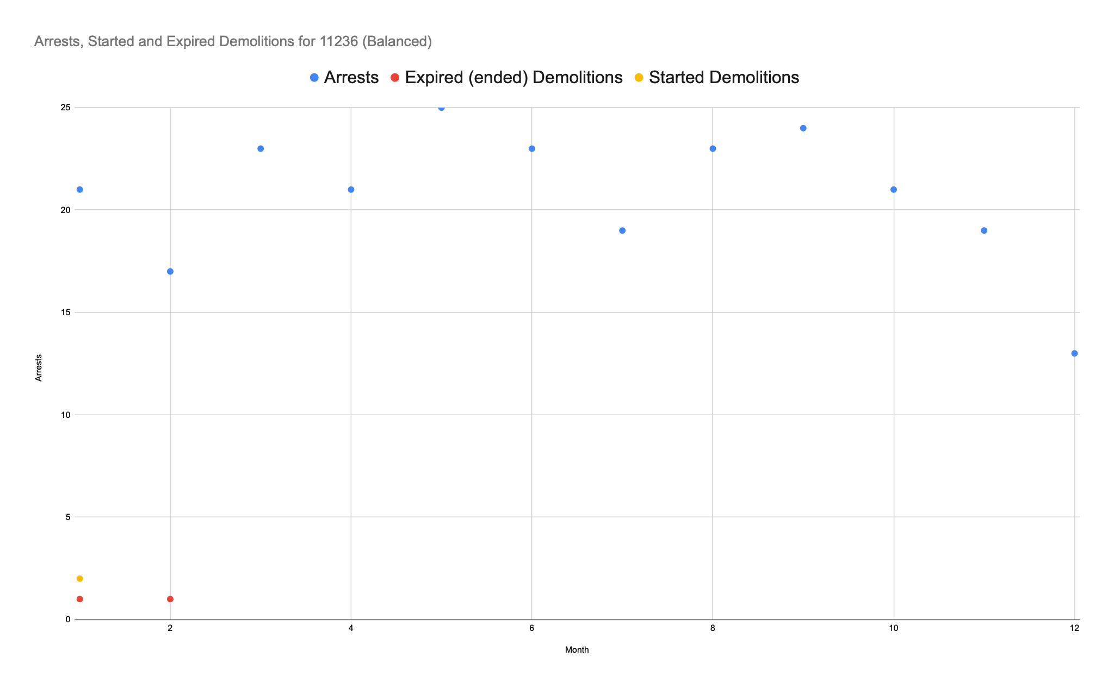
Insights
Demolition correlation with arrests for a balanced zip code.

Slide 9
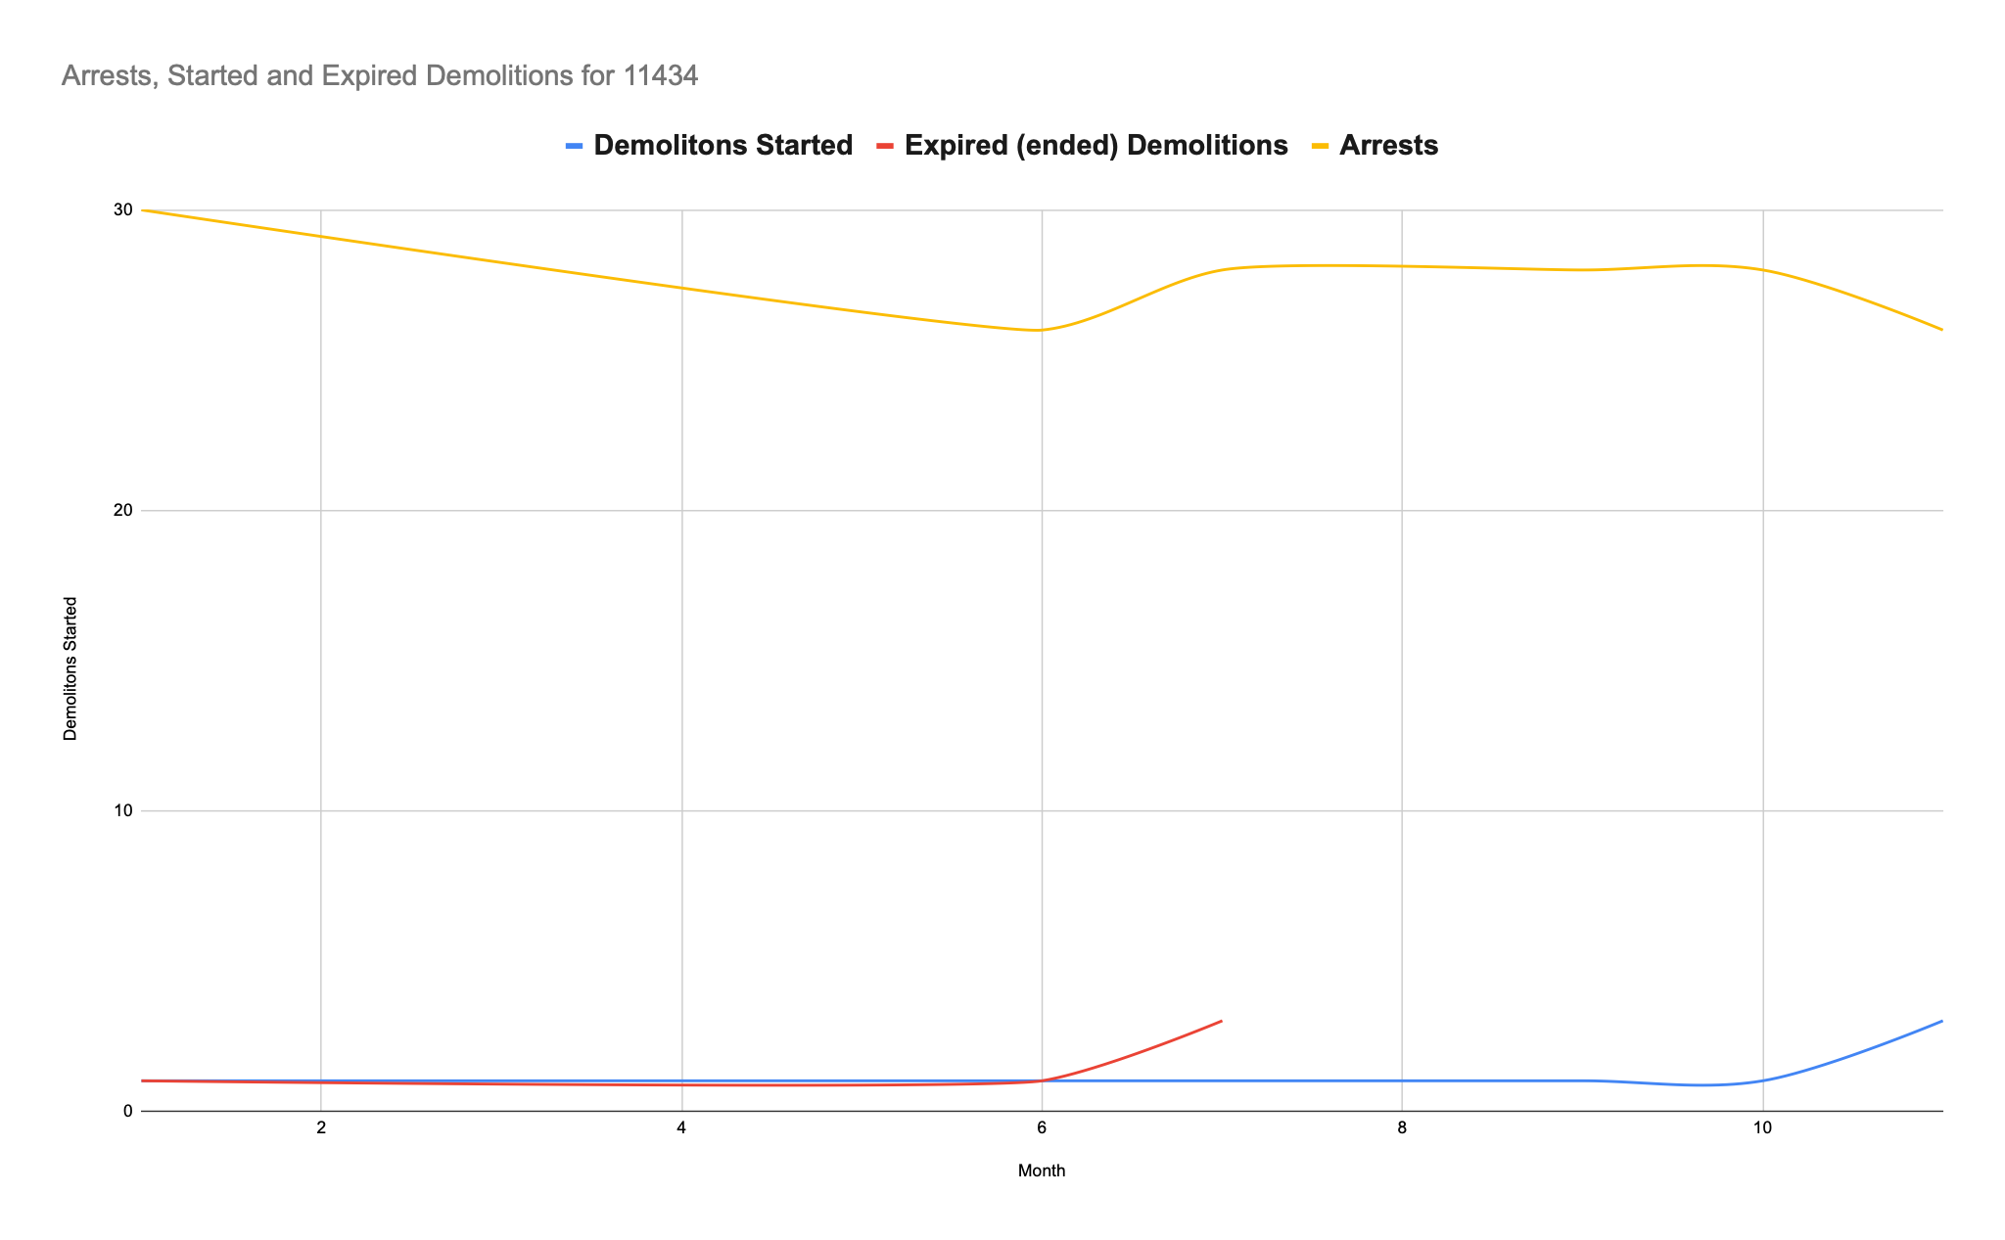
Insights
Demolition correlation with arrests for a balanced zip code.

Slide 10
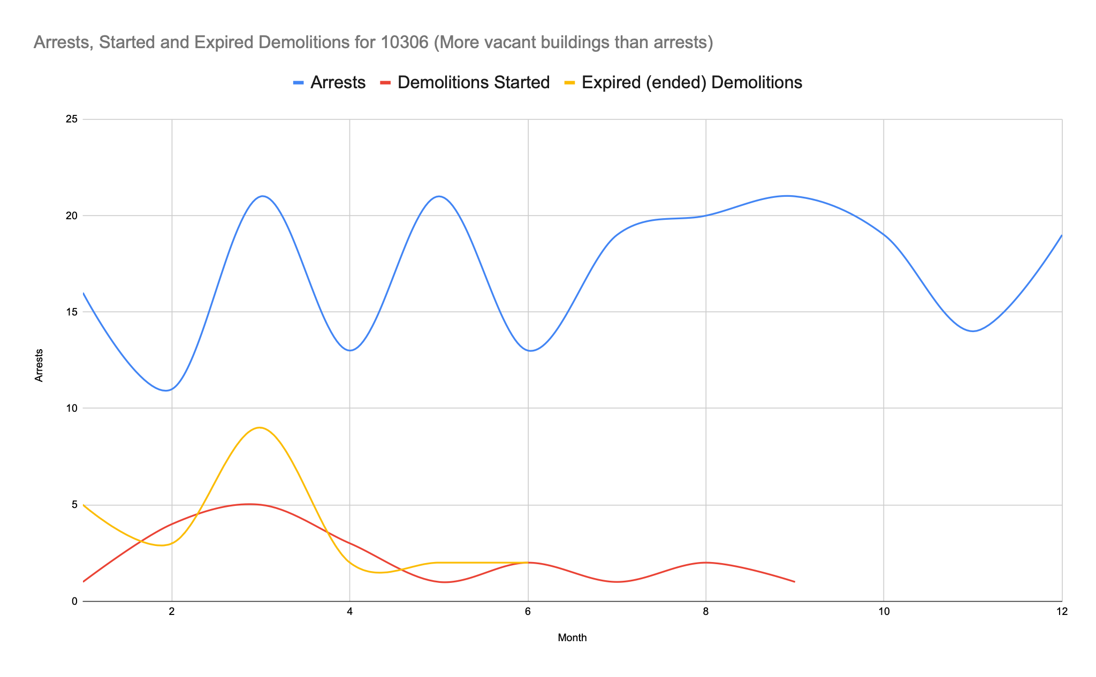
Insights
Demolition correlation with arrests for a unbalanced zip code.

Slide 11
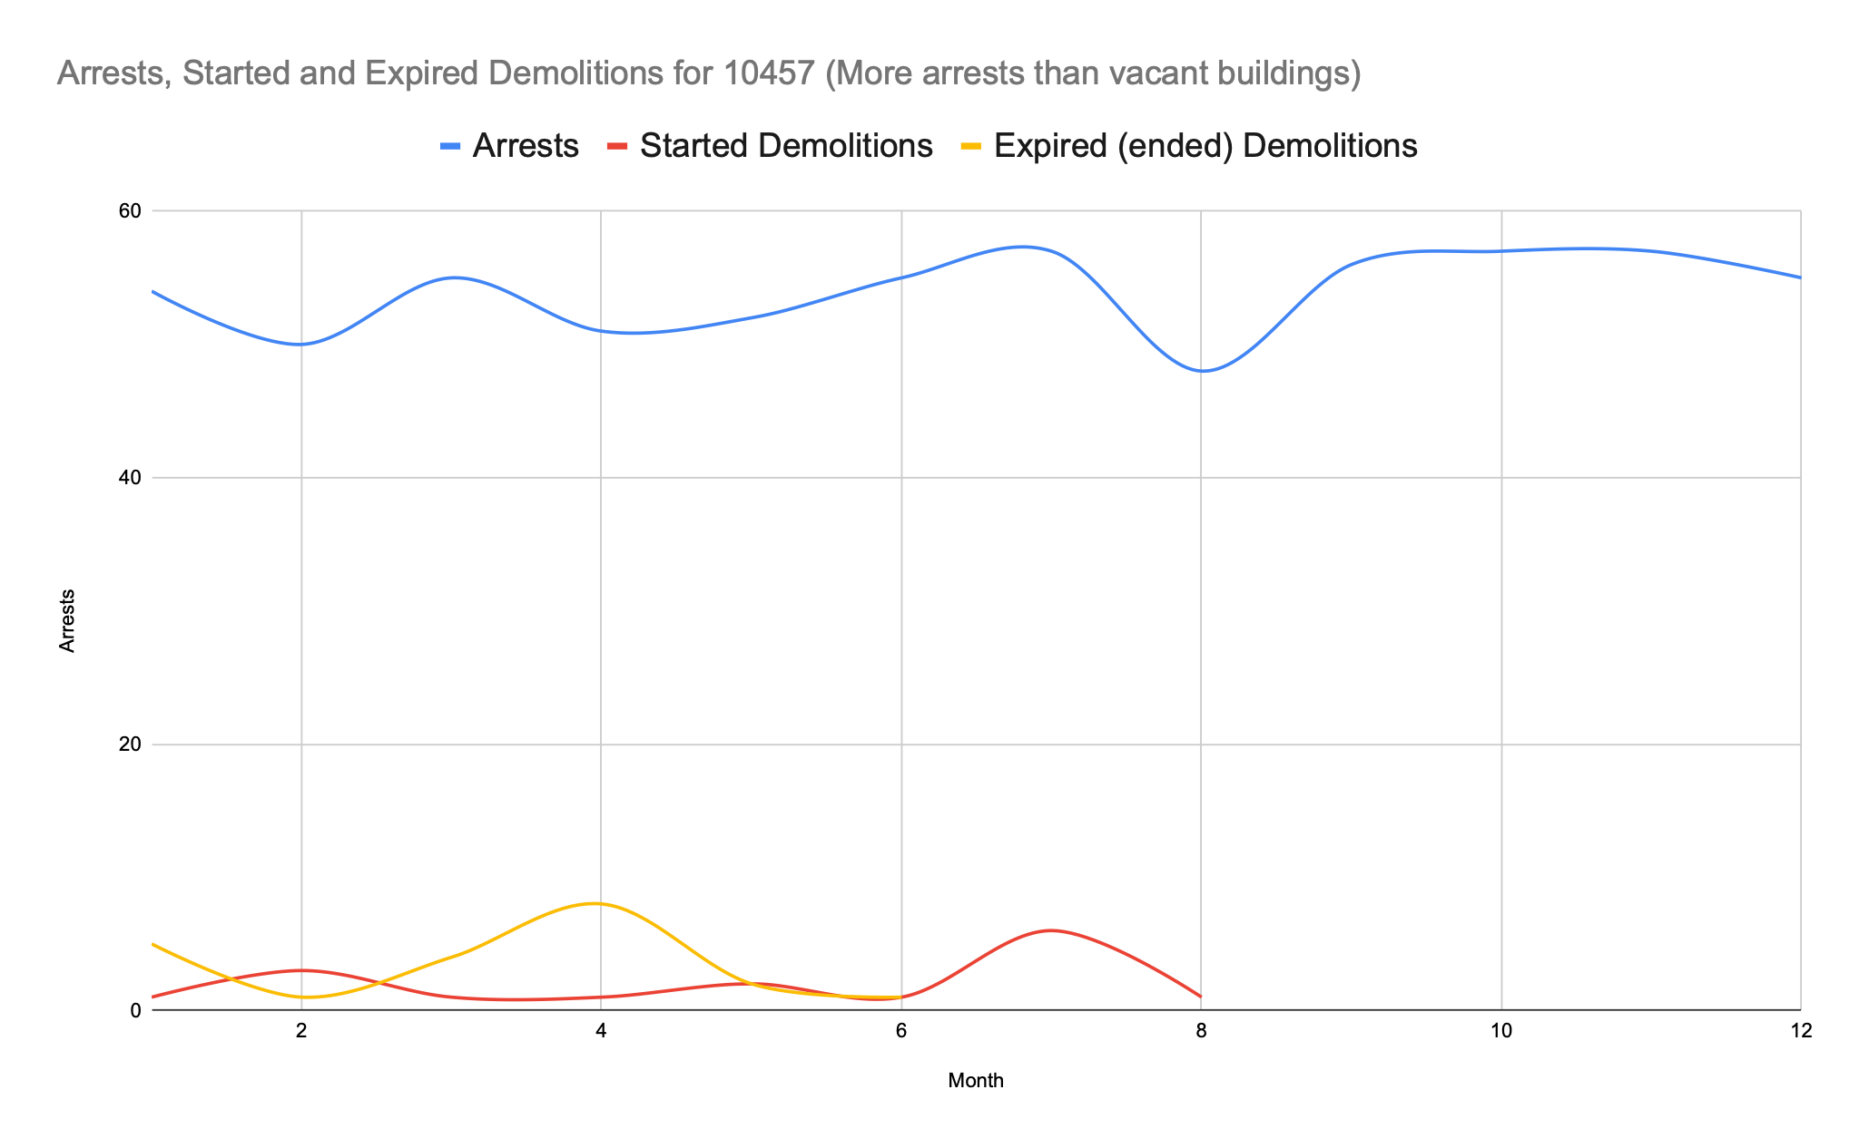
Insights
Demolition correlation with arrests for a unbalanced zip code.

Slide 12
Acknowledgements
Big thanks to HPC as we had some initial technical issues that were sorted out by them.
NYC Police Department provided Zip Codes based of Boroughs
NYC Office of Environmental Remediation provided the Vacant Property Database

Slide 13
References
https://www.sciencedaily.com/releases/2020/11/201110151149.htm
https://www.researchgate.net/publication/345410066_Does_Demolition_Lead_to_a_Reduction_in_Nearby_Crime_Associated_With_Abandoned_Properties/link/6013a3b192851c2d4dfeed08/download
https://data.cityofnewyork.us/Housing-Development/DOB-Permit-Issuance/ipu4-2q9a
https://data.cityofnewyork.us/Public-Safety/NYPD-Arrest-Data-Year-to-Date-/uip8-fykc
https://www1.nyc.gov/site/nypd/bureaus/patrol/precincts-landing.page
https://www1.nyc.gov/assets/planning/download/zip/data-maps/open-data/nyc_pluto_21v4_csv.zip

